Slide 1

Indian Institute of Information Technology Kalyani
8th Semester Project (CS – 891)
Quantum Simulation
Mentored By – Dr. Anirban Lakshman

Slide 2
MEMBERS
Akash Ramanand Rajak 435 19008
Amaan Khan 438 19011
Pallav Dubey 481 19054

Slide 3
Introduction
Quantum simulation refers to the use of quantum computers or other quantum systems to simulate and analyze complex quantum systems that are difficult to study using classical computers.
It is a computational technique used to study and understand complex quantum systems that are difficult to simulate using classical computers.
Quantum simulation is a powerful computational technique that offers a way to study and understand complex quantum systems, and has the potential to revolutionize many fields, from chemistry and materials science to cryptography and machine learning.

Slide 4
Motivation of the Work
Advancements in technology: The development of quantum computers and other quantum systems has created new opportunities for quantum simulation, and researchers may be motivated to explore the potential of these technologies to simulate the behavior of complex quantum systems.
Applications in various fields: Quantum simulation has potential applications in a wide range of fields, including chemistry, materials science, condensed matter physics, and high-energy physics.
By simulating the behavior of quantum systems, researchers can evaluate the performance of quantum computers and optimize the design of quantum algorithms for specific tasks.

Slide 5
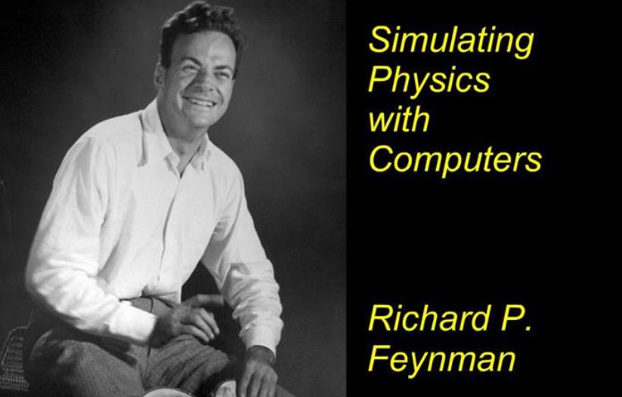
Literature Survey
In the past years various articles and publications are being done in the field of Quantum Simulation.
1982 – “Simulating Physics with Computers" by Richard Feynman (1982): This paper proposed the concept of using quantum computers to simulate the behavior of quantum systems, and is widely regarded as a foundational paper in the field of quantum simulation.

Slide 6
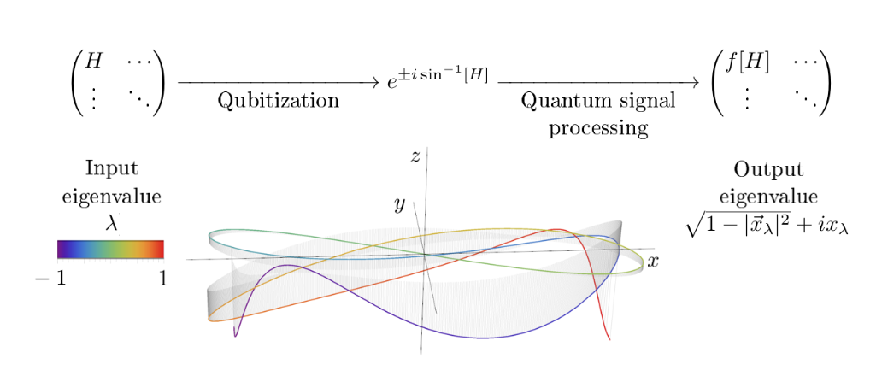
2000 – "Quantum Simulation of Hamiltonian Dynamics" by E. Farhi, J. Goldstone, S. Gutmann, and M. Sipser (2000): This paper presents an algorithm for simulating the dynamics of a quantum system using a quantum computer. The authors demonstrate that their algorithm can simulate a range of Hamiltonians and can be used to study the behavior of quantum systems that are difficult to model using classical computers.

Slide 7

2006 – "Quantum simulation of lattice gauge theories using Wilson fermions" by Martin Müller et al. (2006): This paper describes a quantum simulation algorithm for simulating lattice gauge theories, which are important models in particle physics. The authors demonstrate that their algorithm can simulate the behavior of these theories using a quantum computer.

Slide 8
2012 – “Quantum Simulation of Many-Body Physics with Trapped Ions" by R. Blatt and C. F. Roos (2012): This paper discusses the use of trapped ions for quantum simulation. The authors describe how these systems can be used to simulate many-body quantum systems and demonstrate their use in studying the behavior of condensed matter systems.
2013 – "Quantum Simulation with Preconditioned Operator Splitting" by A. W. Harrow, A. Hassidim, and S. Lloyd (2013): This paper presents a quantum simulation algorithm that uses preconditioned operator splitting to simulate the behavior of quantum systems. The authors demonstrate that their algorithm can be used to efficiently simulate a wide range of quantum systems, including those that are difficult to simulate using classical computers.

Slide 9
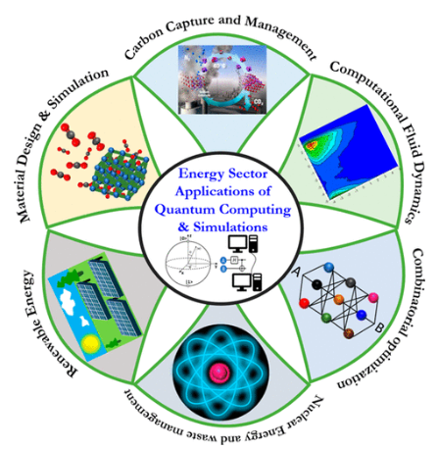
Fields of Quantum Simulation
Chemistry and Materials Science.
Condensed Matter Physics
High Energy Physics
Quantum Computing
Machine Learning
Finance
Cryptography

Slide 10
Quantum Simulation in Real Life
Variational Quantum Eigensolver (VQE)
Quantum Phase Estimation (QPE)
Quantum Approximate Optimization Algorithm (QAOA)
Quantum Monte Carlo (QMC)
Quantum Annealing
Quantum Walk
Quantum Fourier Transform (QFT)
Quantum Amplitude Estimation (QAE)
Quantum Teleportation (QT)
Quantum Error Correction (QEC)

Slide 11
Comparisons Between Simulations
VQE and QPE
VQE is used for finding the ground state energy of a quantum system, while QPE is used for estimating the phase of an eigenvalue of a unitary operator.
VQE uses a parametrized quantum circuit and classical optimization techniques, while QPE relies on quantum circuitry to estimate the phase of an eigenvalue.
VQE can be used in conjunction with QPE to prepare initial states for VQE optimization, which can help in obtaining more accurate results.

Slide 12
QMC and Quantum Walk
QMC is a simulation-based method that uses classical Monte Carlo techniques to estimate properties of quantum systems, while Quantum Walk is a quantum algorithm used for searching, graph problems, and simulation tasks.
QMC can be implemented on classical computers, while Quantum Walk requires quantum computers to exploit the quantum properties of quantum walks.
QMC typically involves classical random sampling, while Quantum Walks involve quantum interference and evolution.

Slide 13
QFT and QAE
QFT is a quantum algorithm used for transforming a quantum state from the computational basis to the Fourier basis, which has applications in many areas of quantum computing.
QAE is a quantum algorithm used for estimating the amplitude of a marked state in a quantum superposition, which has applications in quantum search algorithms and quantum machine learning.
QFT and QAE have different underlying principles and implementations, with QFT focused on transforming quantum states and QAE focused on amplitude estimation.

Slide 14
QT and QEC
QT and QEC are both quantum algorithms, but they have different goals and implementations.
QT is a quantum protocol used for transferring the quantum state of one qubit to another qubit, using entanglement and classical communication.
QEC is used for protecting quantum states from decoherence and errors caused by the environment, using error-correcting codes and quantum gates to detect and correct errors.
QT and QEC are used in different contexts, with QT focused on state transfer and QEC focused on error mitigation.

Slide 15
QAOA and QPE
QAOA and QPE are both quantum algorithms used for estimating quantities related to quantum systems.
QAOA is used for solving combinatorial optimization problems, while QPE is used for estimating the phase of an eigenvalue of a unitary operator.
QAOA uses a parametrized quantum circuit with a specific structure known as a QAOA ansatz, while QPE relies on quantum circuitry to estimate the phase of an eigenvalue.
Both QAOA and QPE require classical optimization techniques to find optimal parameters or estimates.

Slide 16
QAE and QT
QAE and QT are both quantum algorithms used for specific tasks in quantum computing.
QAE is a quantum algorithm used for estimating the amplitude of a marked state in a quantum superposition, which has applications in various quantum algorithms, including Grover's algorithm for quantum search.
QT is a quantum communication protocol that allows for the transfer of quantum information between two distant qubits using entanglement and classical communication.

Slide 17
QFT and QT
QFT is a quantum algorithm used for transforming a quantum state from the computational basis to the Fourier basis, while QT is a quantum protocol used for transferring the quantum state of one qubit to another qubit.
QFT is a fundamental operation in many quantum algorithms, while QT is a practical application of quantum entanglement for quantum communication.
QFT is a deterministic process, while QT involves probabilistic measurements and classical communication to transfer the quantum state.

Slide 18
Quantum Walk and Quantum Annealing
Quantum Walk is a quantum algorithm that uses the quantum properties of superposition and interference to perform search or graph-related tasks.
Quantum Annealing is a quantum algorithm that uses the quantum properties of a physical annealing system to search for the optimal solution of an optimization problem.
Quantum Walk typically involves discrete-time or continuous-time evolution of a quantum state, while Quantum Annealing involves annealing a quantum system towards the optimal solution of an optimization problem.

Slide 19
QAE and QEC
QAE is a quantum algorithm used for estimating the amplitude of a marked state in a quantum superposition, which has applications in quantum search algorithms and quantum machine learning.
QEC is used for protecting quantum states from decoherence and errors caused by the environment, using error-correcting codes and quantum gates to detect and correct errors.
QAE and QEC have different goals and implementations, with QAE focused on amplitude estimation and QEC focused on error mitigation and fault-tolerant quantum computing.

Slide 20
Quantum Simulation Techniques
Here listed the 5 most common techniques:
Hamiltonian Simulation
Quantum Circuit-based Simulation
Variational Quantum Simulation
Tensor Network Methods
Quantum Monte Carlo Methods

Slide 21
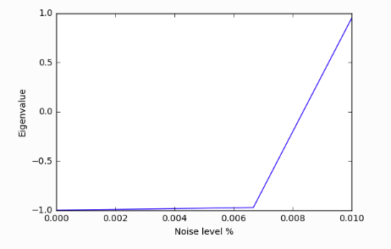
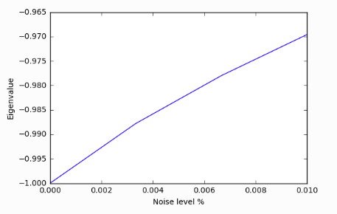
Results
Noisy VQE Plot

Slide 22
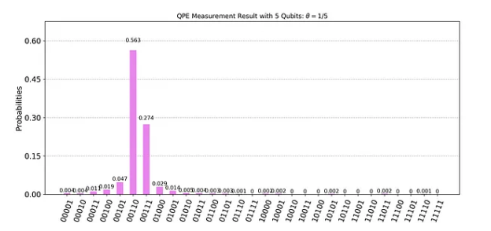
QPE Measurement Result for 5-Qubit System

Slide 23
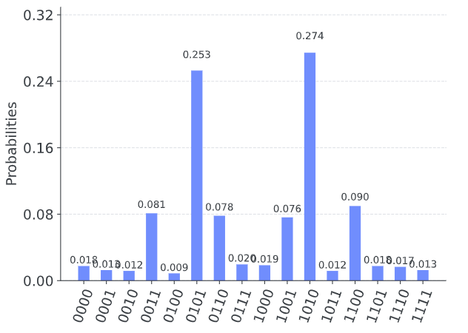
QAOA Probability measurement with 4-Qubit system

Slide 24
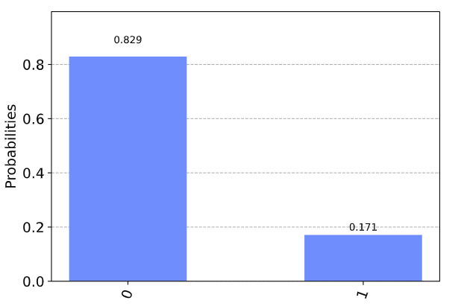
Quantum Teleportation Probability measurement with 1-Qubit system

Slide 25
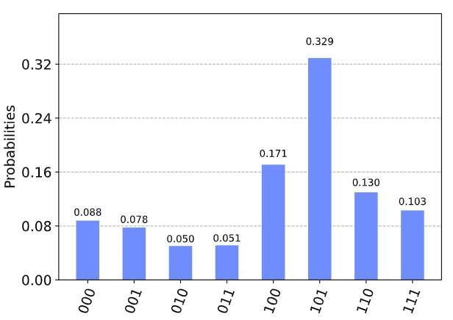
QFT Probability measurement with 3-Qubit system

Slide 26
Future Directions and Challenges
Here are some of the common challenges and directions:
Scalability Factor
Error Mitigation and Error Correction
Hybrid Approaches
Novel Simulation Techniques
Application-specific Simulations
Validation and Benchmarking
Accessible Tools and User-friendly Interfaces
Ethical and Societal Implications

Slide 27
References
[1] Feynman, Richard P. "Simulating physics with computers." Feynman and computation. CRC Press, 2018. 133-153.
[2] Haferkamp, Jonas, et al. "Closing gaps of a quantum advantage with short-time hamiltonian dynamics." Physical Review Letters 125.25 (2020): 250501.
[3] Zache, Torsten Victor, et al. "Quantum simulation of lattice gauge theories using Wilson fermions." Quantum science and technology 3.3 (2018): 034010.
[4] Blatt, Rainer, and Christian F. Roos. "Quantum simulations with trapped ions." Nature Physics 8.4 (2012): 277-284.

